Slide 1

MemberClicks 101
Pilot International
Notes:
At some point in a world long long ago the dream of AMS was that it could help you realize this imagined world….. But it isn’t working

Slide 2
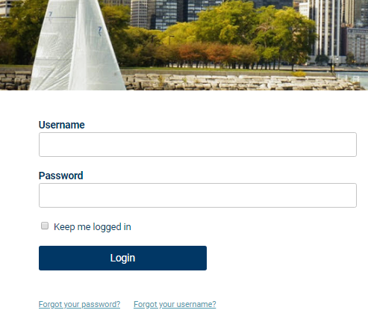
Take Control of Your Membership
To get to the login page, go to pilotinternational.org and click the “Member Login” button on the top righthand corner.
If you have forgotten your password, no worries! Click ‘forgot your password’ or ‘forgot username’ and enter the email address associated with your profile. You will then be emailed a link to reset your password.
Note: To receive the link via email, the email address you enter must be the email address in your membership profile.

Slide 3
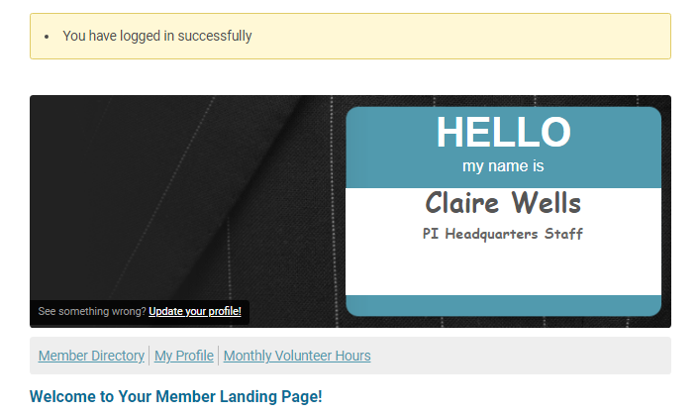
What Can I Do Here?
View your profile
View/ Pay Invoices
Access the Member Directory
View the Event Calendar
Access to Social Community Features
View any members only content on this website
Interact and connect with other members
Make a donation
Complete monthly volunteer hour forms

Slide 4
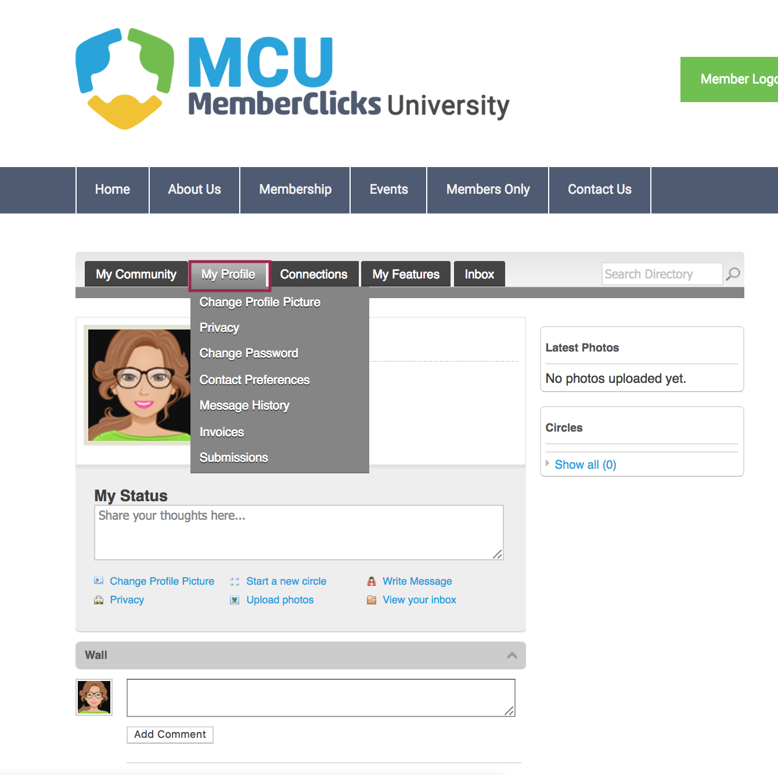
If you hover over the words ‘My Profile’, you can make additional changes to your profile.
In this area you can :
Change your profile picture that shows on the Member Directory
Edit your privacy settings
Change your password
Manage how we contact you
View past emails we have sent to you
View a list of all your invoices
View all forms that you have submitted

Slide 5
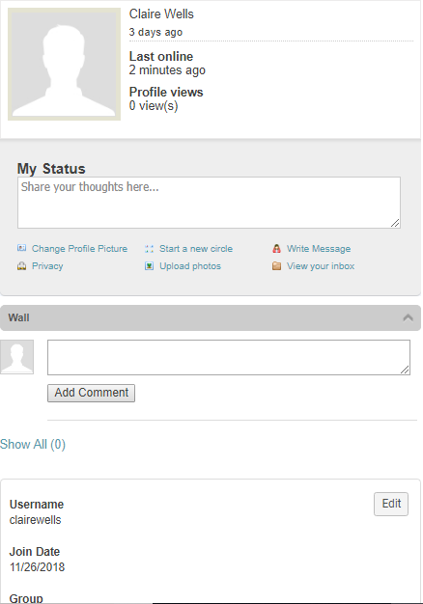
My Profile
These fields show you what information we have now. Please fill in any blanks so that we can know you as well as possible.
Information here can be used on your Directory listings or for communications we send out.
Make sure to click Save at the end of the process.

Slide 6
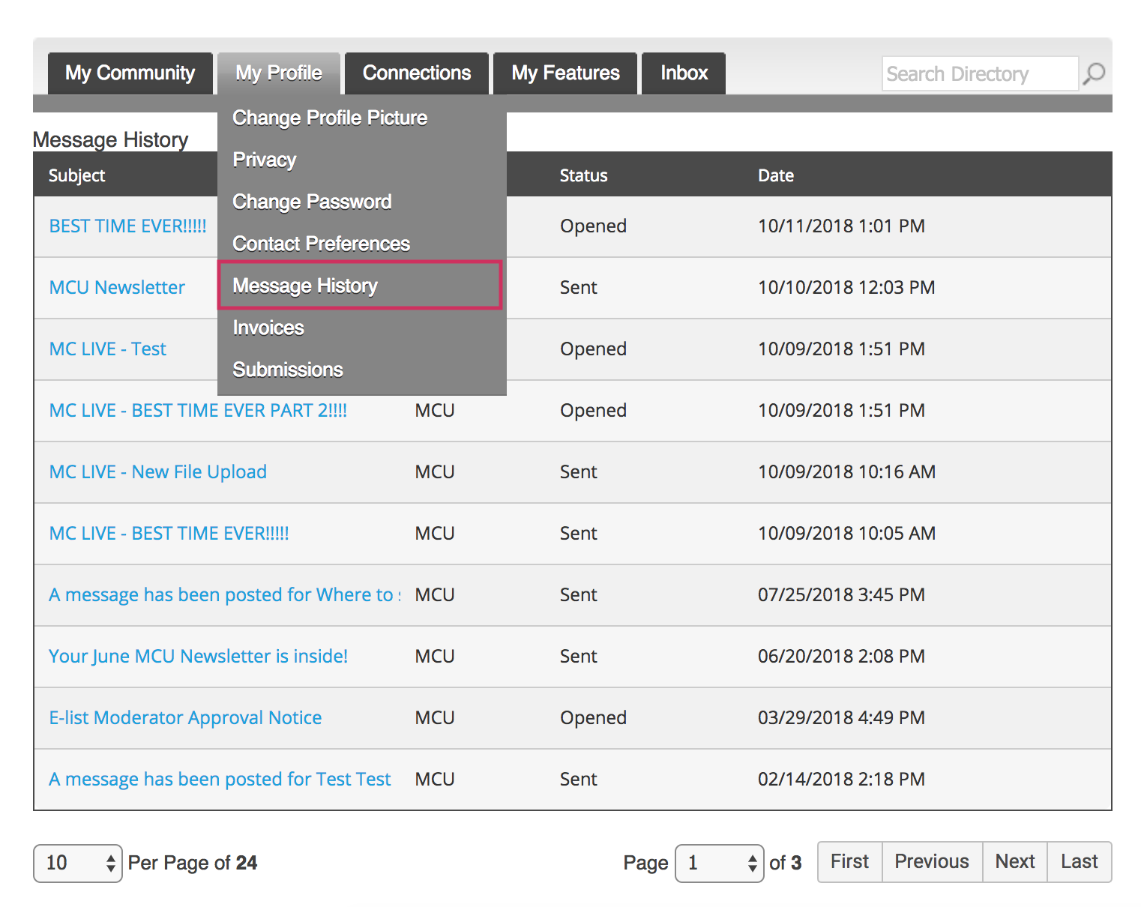
Message History
The Message History area will show you all of the emails the organization has sent to your personal inbox. If you ever delete an email, there is a full record kept in this area of your profile. Simply click on the subject line to open the body of the email.

Slide 7
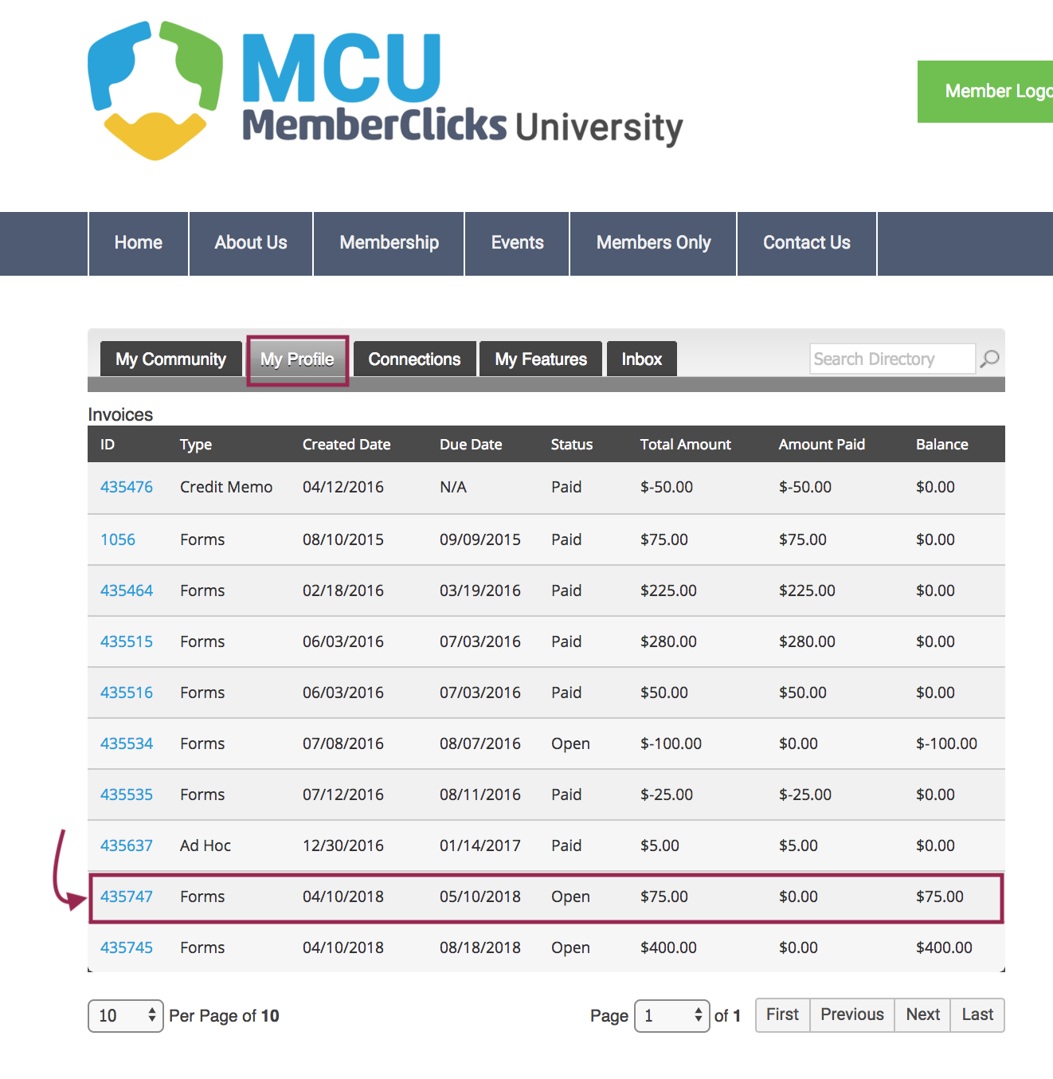
View your Invoices
Under ‘My Profile’ you have the ability to display your invoices.
This area will show you past paid invoices and open invoices that you are able to pay.
To open any of these invoices, simply click on the Invoice ID to view the invoice.

Slide 8
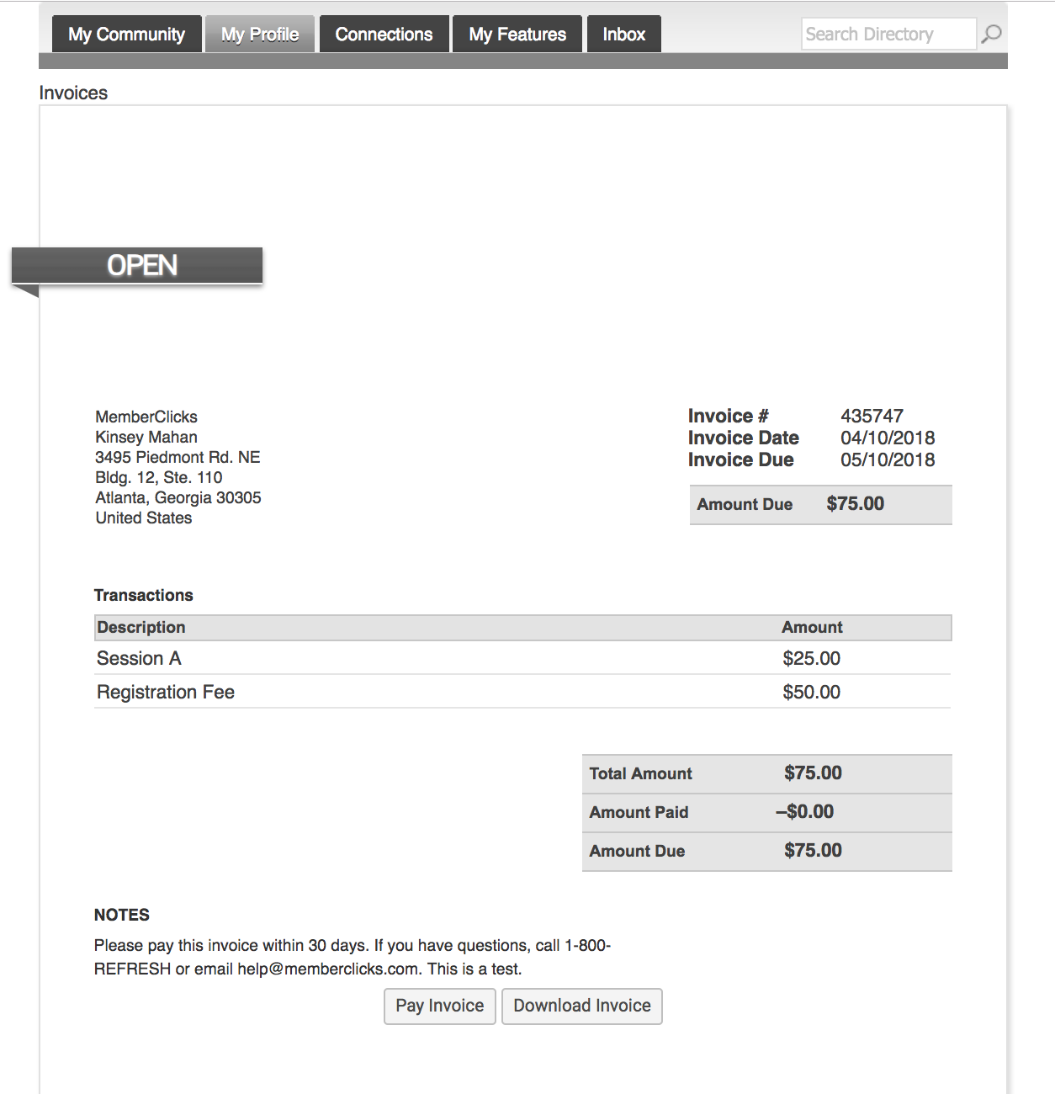
Pay Your Invoices
You must be logged into your account to pay an invoice. Once you have clicked on the Invoice ID
You have the option to pay an open invoice or download an invoice.
Paying an Invoice: Paying an invoice couldn’t be easier. Simply click on the button at the bottom ‘Pay Now. Our payment area will come up for you to enter your card and billing information.

Slide 9

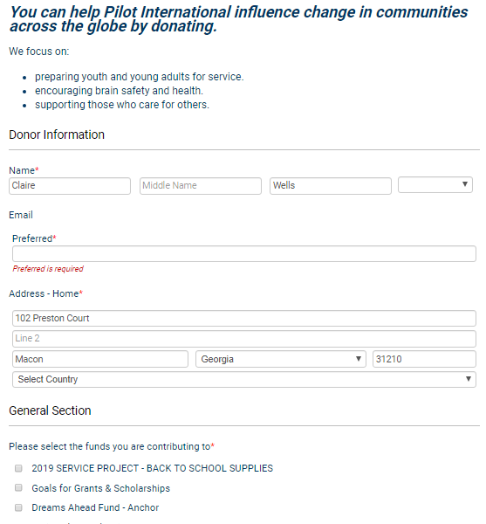
Make A Donation
Once you have logged into MemberClicks, click the donate button at the top of the screen.
Making a Donation: Fill out the form and the payment information.
Note: Clubs and Districts cannot donate through MemberClicks.

Slide 10
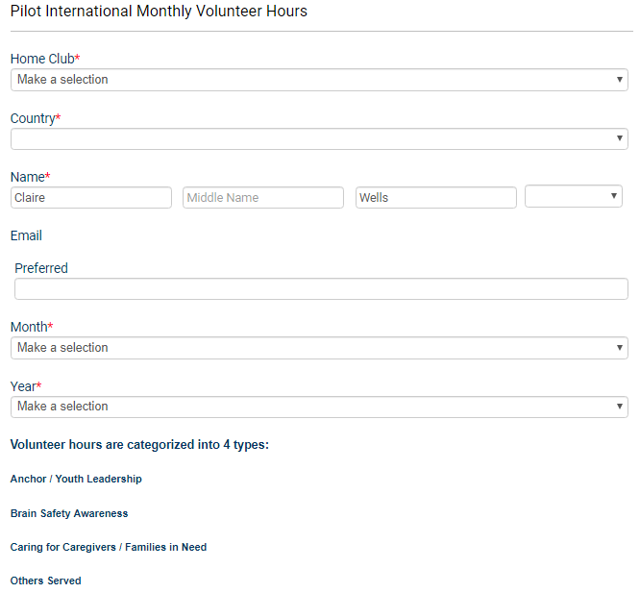
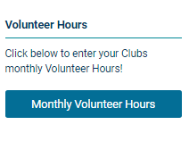
Fill Out Monthly Volunteer Hours Form
You must be logged into your account to complete the form.
Note: Clubs should have one person complete the form for their club monthly. We pull these volunteer hours reports for Pilot Awards, monthly newsletters, etc.

Slide 11
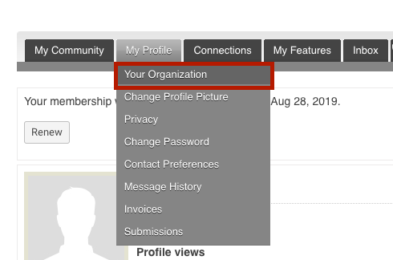
Organization Structure.
Key Contacts changes to Organizational Profiles
If you are the Key Contact (aka: admin) to an Organization, you are able to make changes to the organization profile through your individual profile.
To update your Organization's’ profile, hover your mouse over ‘My Profile’ and click on ‘Your Organization’.

Slide 12
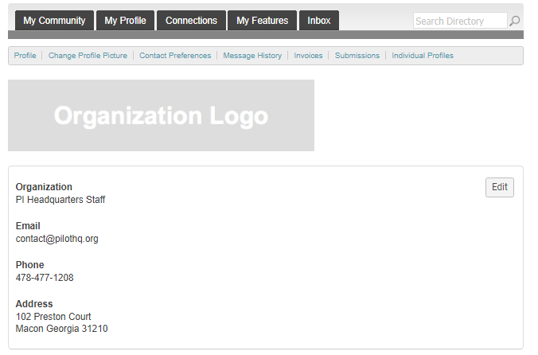
Key Contacts
Information here can be used on your Directory listings or for communications we send.
These fields show you what information we have now. Please fill in any blanks.
Make sure to click Save at the end of the process
NOTE: Information on organization profiles will automatically populate to blank fields on member profiles. For example, if your email is listed on your organization’s profile, it will appear on member profiles of your club that do not have an email address. This will result in you receiving multiple emails.

Slide 13
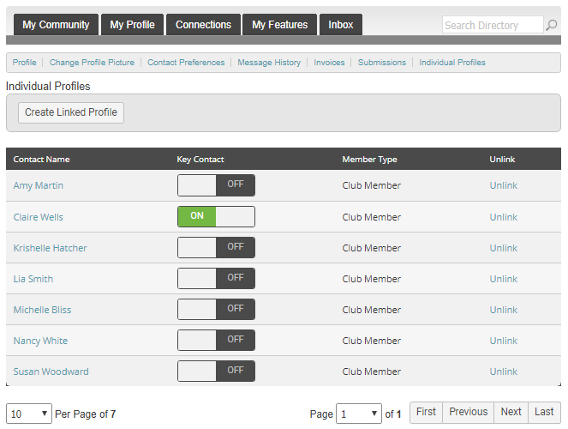
Key
Contacts
This is where your club’s roster will be. Click on the name of the member you wish to edit the basic contact information of.
Note: If you need to add a member, delete a member, or change the status of a member, you must send the necessary forms and funds to headquarters.

Slide 14
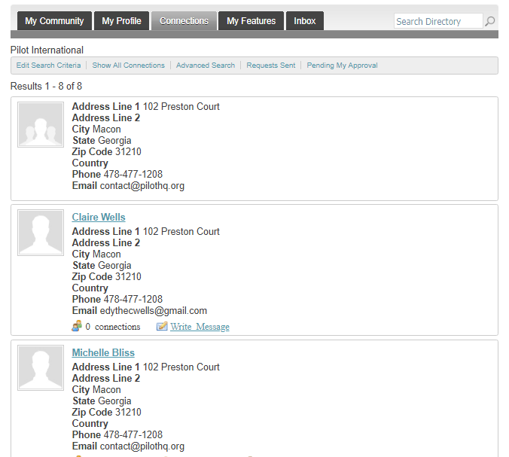
Member Directory
Our Member Directory can be valuable in connecting you with other members. To update what displays for your profile in the directory listing, please edit your profile that were provided in the earlier steps.

Slide 15
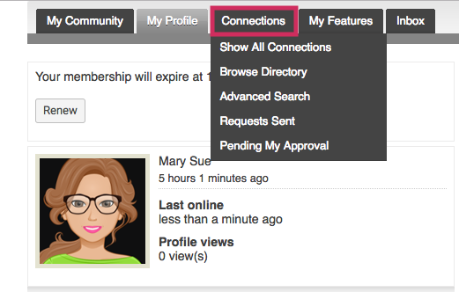
Connections
This area provides the opportunity to connect and build relationships with other members. You can;
See all your connections with other members
Browse the directory
Search for Members
View your connection requests to other members.
See requests from other members to connect with you.

Slide 16
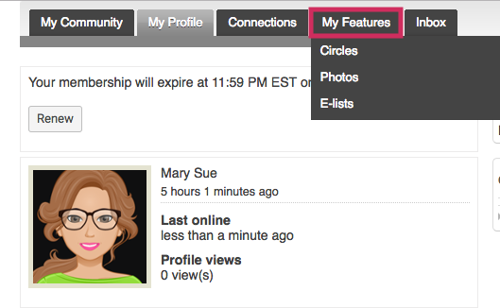
My Features
Your member profile is now a gateway to connect and engage with other members of our community.
Some of the new features of our website include:
Similar to Facebook™ friends or LinkedIn™ connections, you can now form connections with your friends and colleagues.
Create albums and upload photos to your profile to share with other members.
Status messages give you a way to share what you’re working on with other members.
Profiles have a “wall” where connections can leave messages for each other.
Join user driven circles for special interest and discussion groups. You can create photo albums within Circles too!

Slide 17

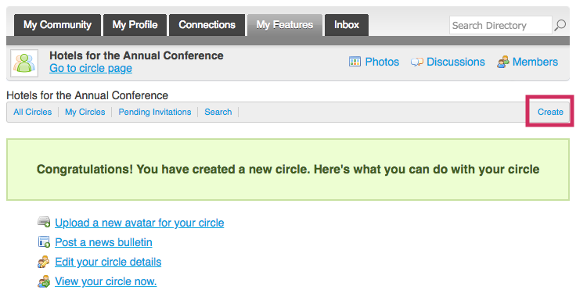
Circles
User driven area for discussions and networking. Circles allow members to create and manage special interest groups within the social community area of their profile. Circle participation allows members to share photo albums, announcements and private discussion forums.

Slide 18
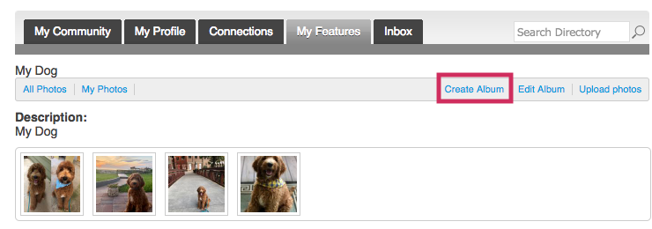
Photos
Members can add photo albums to their profiles or they can share photos within their circles

Slide 19
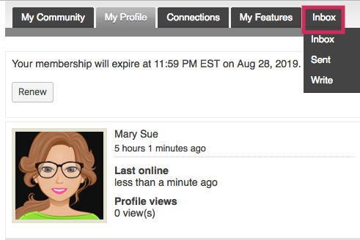
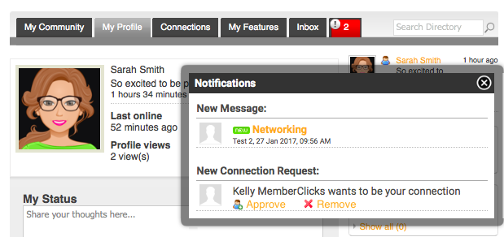
Inbox
Your Inbox will show you messages between you and other members. These are private direct messages between you and one other member.

Slide 20
Updates Since Chicago
I can now run reports and see who has logged into MemberClicks before!

Slide 21
Need Help? Contact Me!
Claire Wells – Director of Club Services
  Email: clubservices@pilothq.org
  Phone: 478-477-1208, ext. 308

