Slide 1


Volunteer Hours
For
Pilot International
Notes:
Good morning! How many of you joined Pilot International because you loved paperwork? No one?
How many of you became a Pilot so you could keep a record of every minute you spend working for others? hmmm You didn't?
How many of you stay in Pilot for the plaques and trophies and loving cups you can earn? I didn't think you did.

Slide 2
Volunteer Hours
For
Pilot International
Friendship and Service
Notes:
I believe most of you joined this organization for the friends you make and the service you can give. I know that we each have a lot to give right by our own-selves -- In fact there's an African proverb that says "if you think you are too small to make a difference, try sleeping with a mosquito!" BUT we are even stronger together! That's one main reason that I joined the Pilot Club in my hometown, and I haven't talked to anyone else whose reason was very different from mine.

Slide 3
WHY ALL THE
CONFUSION
ABOUT
VOLUNTEER HOURS
ALL OF A SUDDEN?
Notes:
Why are we so confused about Volunteer Hours all of a sudden? For quite a few years, Pilot International has asked members of Pilot to go online each month and record how many hours they had individually given to volunteering for Pilot. Who has been doing that? I think I may have looked at that page, but I didn't record any of my volunteer hours there.
Last year, that recording of hours was simplified. Uh huh. I said "simplified." I did not ask anyone why, but I have a theory. It's unofficial, but I think it makes sense. Now, only one member of the club is to put the hours for everyone in the club online, so I think the members were not going online individually todo it. In order to get those hours, PI changed the recording process.
Doing it this way -- one person in the club keeping up with everyone's hours who is charged with recording them, the hours may have a better chance of being recorded.

Slide 4
WHY ARE
GEORGIA clubs
confused
by how to keep
VOLUNTEER HOURS
ALL OF A SUDDEN?
Notes:
When I joined Pilot in 2014, I was told that Pilots were about service. I was taught to keep track of any volunteering I did in my Pilot shirt or while wearing my pin; service ---to the community and friends and other Pilots was to be kept as volunteer service hours, along with time I spent working on service projects for the club with other members.

Slide 5
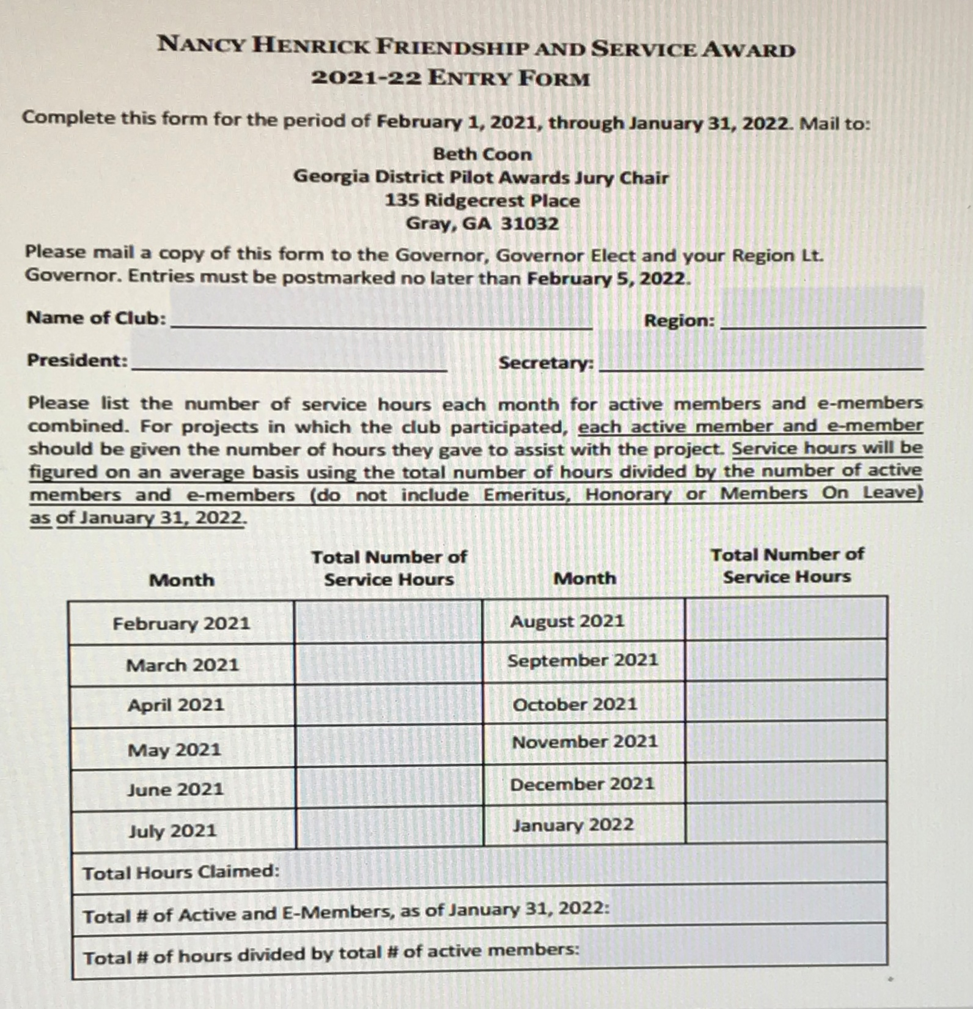
Notes:
Why did Georgia Pilots who had not been putting the hours on the PI site, been keeping up with their hours anyway? Because, in Georgia, we could apply for the Nancy Hendrick Friendship and Service Award. Not all clubs would apply for it, but quite a few did, and DO. My club did. In Cochran, we kept up with the hours we spent on a calendar. We totaled for each month, then turned in the monthly totals every six months, we didn't even have to turn it in more than once a year, though, because look at this form. We could procrastinate, start keeping hours in February and wait until January to give our hours to the secretary or person in charge. As long as he or she had time to total the service hours and mail the form to the Awards Chair, our club could apply for the Nancy Hendrick Award. All that was required was the total number of hours every month for a year. And remember, there were few rules to follow for the hours we may count, but they were pretty clear. Actually, the Nancy Hendrick Friendship and Service Award is still optional; it is not something every club even does. Here's another advantage If you keep up with Service Hours the new way, though, filling out the form for this award will be a snap for your secretary or the member who is assigned that task.

Slide 6
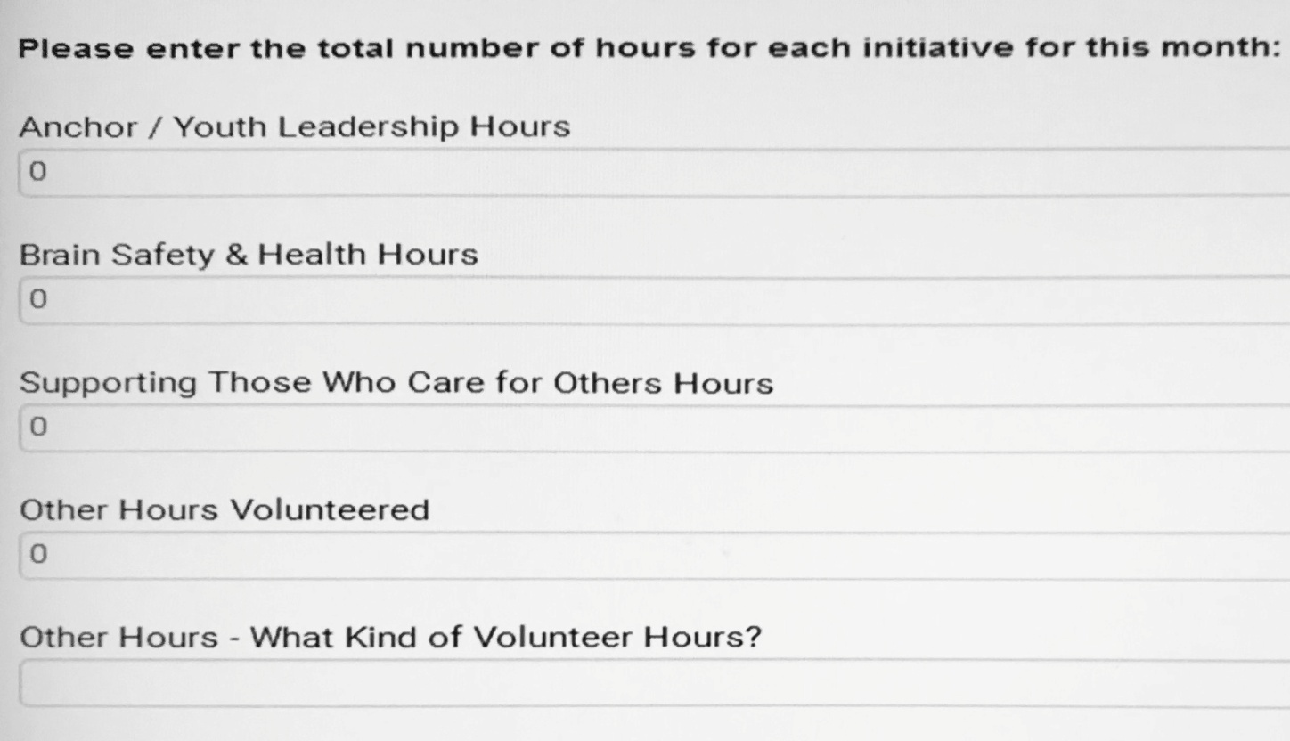
Gather the Necessary Information
Notes:
Let's look at what information you need to record your club's service hours. Remember to apply for the Nancy Hendrick Award, you need to know how many volunteer hours your club members worked for the year. Now, under the new online reporting, you record your club's service hours monthly, or at least every quarter--since club presidents now put the total number of service hours at the top of their Quarterly Reports, they need to know the hours totaled for three months at a time -- they need to compile the hours at least once a quarter.
Notice the four categories:
Anchor -- not actual hours your Anchor club puts in, but the hours your club spends helping the Anchor club.
Brain Health -- time you spend on BrainMinders or Brain-O or Alzheimer's Walks or educating others about the brain.
Caring for Caregivers-- the hours you spent Caring for people who take care of others --hours you prepared Pick-Me-Ups for Nurses, EMTs, Teachers, Policemen, Members of the Sheriff's department, and people who take care of individual people.
Those are the ABCs of Pilot Volunteer Hours.
The "Other" category contains the Other Hours, including the time you spent actually caring for someone else, the time you were a caregiver - maybe you took a Pick-Me-Up to someone under the weather or depressed -- those hours go under "Others." or Community Service, for instance. Time you gave to make your town or county a better place: Maybe a member represented Pilot Club on a board for another non-profit organization - those hours also go under "Others".
So, one new piece of information to be reported is the category each hour fits under Anchor, Brain Health, Caring for Caregivers, or Others. Add to the "other" category, that you need to tell what those "Other" hours were FOR.

Slide 7
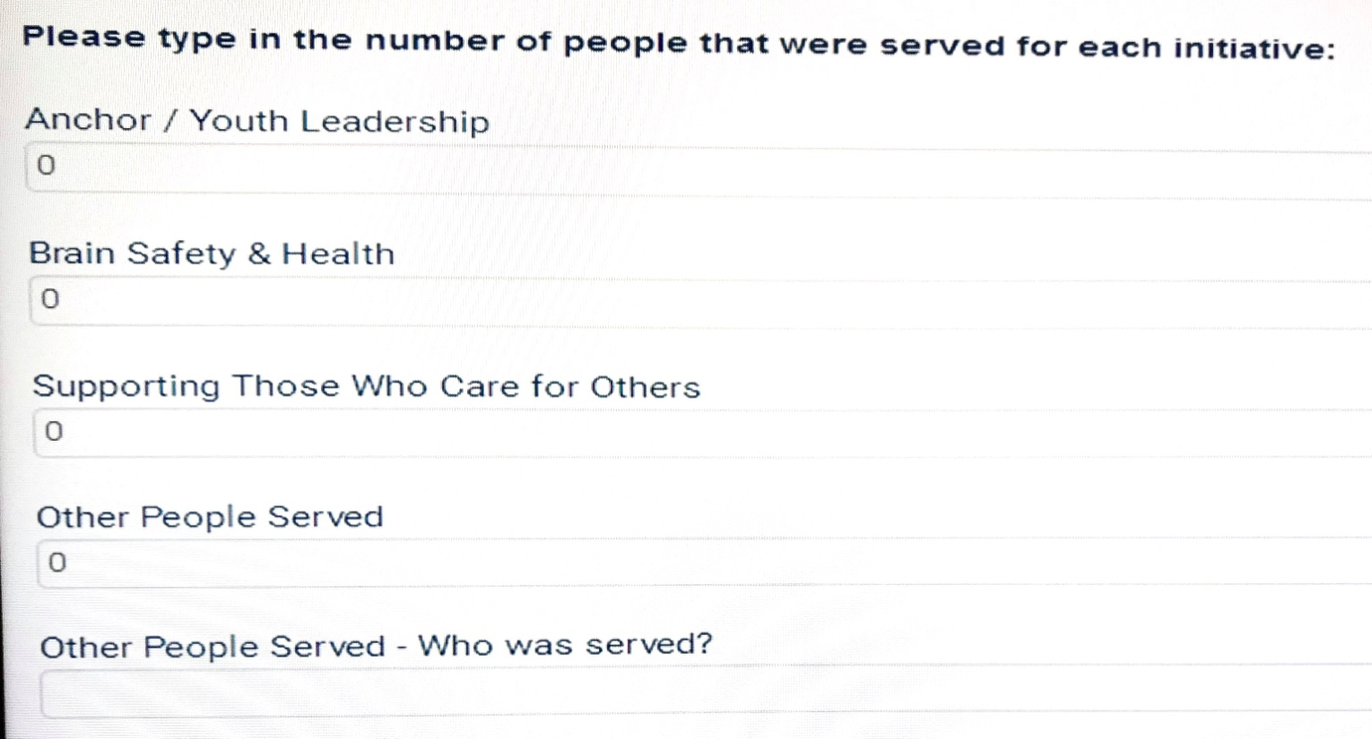
Gather the Necessary Information
Notes:
We have recorded club hours after dividing them into four categories and defined how the hours under Others were spent. Next, we are to keep track of how many people were served by your club in each category. Counting the number who saw a BrainMinder presentation is easy, figuring out how many benefitted from five members of the club cleaning up trash on Main Street gets a little trickier. Also under the "others" number of how many were served, is a blank to explain who was served by the club members who gave their time.
The first time I went into the website to record my numbers, I was unprepared. Knowing what is asked for prepares you to gather the right information beforehand; filling in these blanks is easy and quick if you figure it all out before you sit down at the computer.
When PI changed the way they want us to keep up with volunteer hours, the person responsible for putting in the hours, had to place them in certain areas, AND had to report how many people were helped in those certain categories, AND had to explain to the club members that they didn't just need to turn in those hours every month, but had to categorize them, as well, and report how many people benefitted from those hours. Most club members reacted like the IRS had just sent a notice that they were being audited.

Slide 8



Notes:
How do I know this? Because I was the one in our club who tried to gather the hours from our members to record on the PI site. I also was in the Volunteer Hours Training at the PI convention last July. There were some people hotter than the Atlanta sun in that meeting. I think my club may have figured out an easier reporting system this year, but I lost a lot of "cool points" in the process!

Slide 9
Why bother with
reporting hours on the PI site anyway?
Notes:
My fellow club members and some of you have asked this because it seems selfish, anti-spirit-of-service, doesn't it? You don't care about keeping track of all the good you do, after all, because that takes away from the time you have to do good! Elizabeth Andrew said, "Volunteers do not necessarily have the time; they just have the heart." You do Pilot like it's your job, after all; volunteering is your superpower! I've heard members say that keeping up with their hours is like bragging. "It's the service that's important," they say. I know that the Bible says that people who get rewarded for good works on earth may not get a reward in heaven; that they already have their reward (Matthew 6:2), but keeping up with your hours is not about you as much as it is about Pilot International!
So, why should we take the time to do this for Pilot International?
Well, PI provides us with the justification for a 501C3 classification. That means we are tax-free. That means contributors can take donations to us off their 1040 each year. PI uses your hours to prove that we are a volunteer non-profit organization. That's why they want to know what we are doing. That's why we do it.

Slide 10
What counts?
Notes:
PI needs us. If you don't really enjoy keeping records of things, find a member who does--who likes data--who likes organizing and keeping track of things the way your math or science teacher did!
So if we are going to do this the way Pilot International needs us to do it, what are the rules? What do we count as service hours and what is a no-no?
How do we know how to go from "Any service you provide while wearing a Pilot pin or tee counts?" to several things that are not allowed as hours that a non-profit may count?

Slide 11
Hours that do not count as volunteer hours include:
Fundraising for your club where the money is deposited into operations or an unrestricted fund.
2. Church functions
3. Training workshops (ex. PI Power Hour)
Preparation for a meeting, district convention,
or PI convention
Notes:
Sometimes focusing on what we need to leave out is easier. Part of number 1 is underlined because if you are fundraising for a particular project or donation, for instance, scholarships -- that money is not going to a general fund, so you may count hours working to raise that money.
We may not count training hours. We may not count hours doing work for a church, but if your club is participating in a community event like a Bible-reading Marathon, and no one church is sponsoring, but also various community groups, that's not a church, (and that could just be my opinion.)
Finally, Pilot says that we may not count most of the hidden hours we spend getting ready for meetings, like preparing agendas or writing the minutes.

Slide 12
Pilot/Anchor/Compass volunteer service hours will focus on service projects that encourage brain safety and health and support those who care for others. In order to count volunteer hours, the service project should be included in the Club Plans of Work.
Notes:
This statement appears on the PI website before the blanks you fill in with numbers. It's logical and right that the hours we focus on should be within the ABCs of Pilot, and our service usually pertains to those things anyway. I asked Lisa Patterson, our past Georgia District ECR who led the Volunteer Hours training in Atlanta this summer, if hours had to come from a project that was in the plan of work; she said, and I quote, " they should be, but they don't HAVE to be.

Slide 13
Hours that may be counted as volunteer hours include:
Time members dedicate to a service project
(purchasing, assembly and delivery)
2. BrainMinders™ presentation Safety day or bike rodeo
Pilot and Compass members assisting with an Anchor
convention
4. Presenting a Pick Me Up
5. Presenting helmets
Volunteering at a community function and representing
Pilot International by wearing your Pilot shirt and promoting Pilot.
Fundraising for a Matching Grant or a special service
project where the money is restricted to that project.
Notes:
Items 2-7 in this list are specific with little room for questions. Notice that number 7 is the exception to the fundraising no-no we saw in the lists of may NOT be counted. Ah, but number 1 is the key to any questions anyone has about counting Volunteer Hours; it is the ruler, the guideline, the test. If you can fit what you are doing into this statement, if you can justify hours that are not forbidden but those you are unsure about with this statement, then by all means count them.
Look at number 1 closely: " Time members dedicate to a service project (purchasing, assembly and delivery)" Do you have to go to Hobby Lobby to pick up something for a project? You may count the time you spend picking it up -- You may count the time driving to the store and back if you make a trip just to get the supplies! (but you are stretching things if you count the other hour you spend shopping for Christmas decorations that have nothing to do with the project.)
Maybe you have to get several things to put together something to put on display at a benefit. Well, this statement says that the time you spend putting it all together may be counted, also.
And when you get it all done, if it has to be transported across town – that may be counted as well, if it is a service project.
Let number one on things allowed be your guide. If you can make the hours you spent fit into that statement, then feel good about counting those hours.

Slide 14
VOLUNTEER HOURS REPORT SHEET
Name_________________ Month August 2021 Due: Sept. 14, 2021
DATE DESCRIPTION HOURS #Served
_______ __________________________________________ ________ ________
_______ __________________________________________ ________ ________
_______ __________________________________________ ________ ________
_______ __________________________________________ ________ ________
_______ __________________________________________ ________ ________
_______ __________________________________________ ________ ________
_______ __________________________________________ ________ ________
_______ __________________________________________ ________ ________
_______ __________________________________________ ________ ________
Notes:
This is my latest attempt at making gathering the numbers easier. I've just added the people served column. Right now it has become easier to have members write down any hours they think might be countable with a description of what they did. This form is working better than last year's, but the hardest part is still having the hours turned in on time. I ask for the previous month's to be turned in at the business meeting. You will use the method that is best for you. I have an excel sheet to which I transfer all the info--the data--and total it all up before I go online to put the numbers in. My advice to all the select members charged with putting hours on the PI website is to set a deadline, then put online what you have had turned in. A few hours reported is better than no reporting, after all.

Slide 15
Reporting Volunteer Hours is still confusing because a lot of the application is subjective.
Thus, Lisa (Patterson) said to apply the “count” list. If it doesn’t fit, it shouldn’t count.
Notes:
Finally, I want you to know that this record keeping is not worth losing sleep over, nor is it worth losing your cool over, nor is it worth losing friends over. The decision about whether or not some things count is still subjective. You may want to leave it up to each member; your club may want to decide as a group to count the hours for an activity or not. You may want to forget individual service hours altogether and just count hours for projects that are in the plans of work--that way members don't have to turn in hours, because you can count the people there and multiply by the time spent. There may be strong opinions. We are Pilots. We can work all that out. Let the first item under the "Hours that may be counted" be the test for any hours you may be unsure about counting.
Happy serving, fellow Pilots! What a wonderful way we have to be with old friends and make new ones! I am pretty sure we are out of time. Thank you!

