Slide 1


Pilot International
Convention and Leadership Conference
MEMBERSHIP GROWTH WAYS TO SECURE OUR FUTURE
Presentations by:
Karen Ferguson-Bain – Pilot International Membership Coordinator 2020-2021,
assisted by Rhona Espinoza – Vice President Pilot International, 2020-2021
Tammie Jayne Lackey – Governor Georgia District 2019-2020
July 8th , 2021

Slide 2
Welcome to
Membership Growth Ways to Secure Our Future
OPEN FORUM & DISCUSSION

Slide 3
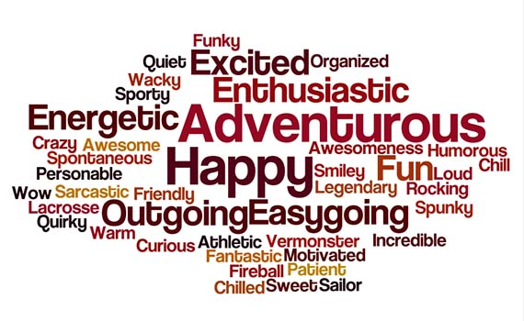
Ice breaker
Share with us your name, Pilot Club and give us one word that best describes you

Slide 4

Short Video 3 Proven tactics to Grow Your Membership Organization

Slide 5
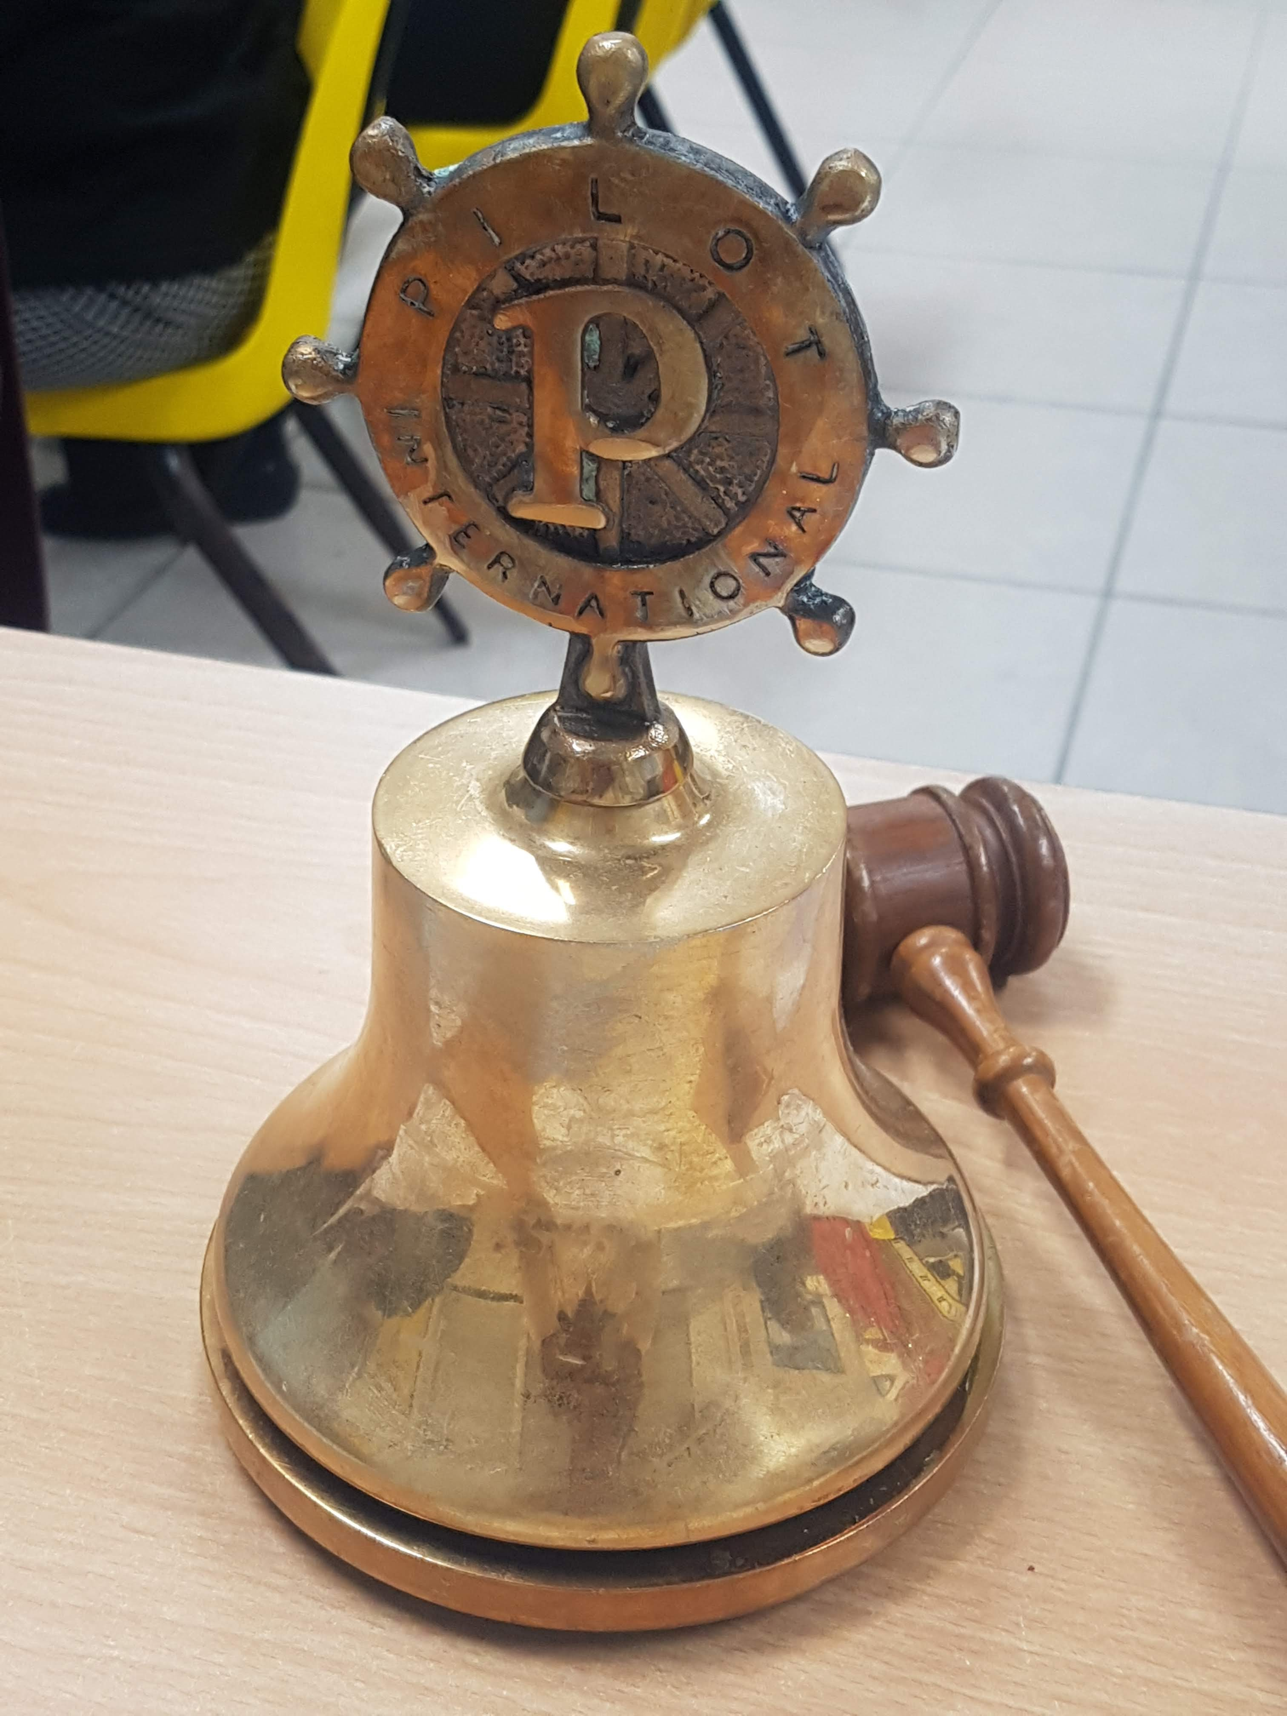

First R’
Recruitment – The action of finding new people to join an organization or support a cause.
Presented by:
Tammie Jayne Lackey;
Governor 2019-2020 Georgia District
Assisted by: Karen Ferguson-Bain International Membership Coordinator 2020/21 and
Rhona Espinoza Vice President Pilot International 2020-2021

Slide 6

Why did you join your pilot club?

Slide 7
Ask…
• we may think it to be obvious that if someone wants to be a Pilot and volunteer that they are just going to come to a meeting and join but that’s most of the time not the case. Lots of time they may be WAITING on US to ask them if they would like to join with us for our cause and volunteer in the projects of Pilot.

Slide 8

• EXTEND - the invitation to attend a Pilot meeting, Share Pilot and better yet invite that person to come and participate in a service project and let them see first hand what goes on during that time and see the team work that takes place during the event. Its’s one thing to talk about service projects but another to participate in one

Slide 9

• VISIBILITY – Promote your club through visibility. Use your social media outlets to promote upcoming activities and fundraisers AND always follow up with pictures of the activity so potential members can see what your club has going on and all the excitement created during the event.
Newspaper – Keep photos of your activities, projects, pick-me-ups, new members, awards, any news regarding your club in the newspaper(s) in your area and/or district.
The more you can keep your club in sight of your current members you have a great chance of gaining new members. This in turn will open up opportunities as you see people that will say to you “I saw your picture in the paper or on social media the other day doing -------” and there is your chance to open up and invite them to come join in on your next meeting or activity and don’t give up if at first, they say no, try, try again!!

Slide 10


• I CAN’T – I know when talking to prospective members they have a misconception that they MUST participate in EVERY project that we have and immediately say I don’t have time to do all of that. BE PREPARED to let them know that each member is not expected to do everything that the club participates in. Each member does what they are able to do when they are able and let them know that we all have different areas that are “pet projects” so to speak that we feel more comfortable with and that we are more experienced in.

Slide 11
So, by joining together we make a difference. Using everyone’s Skills and Talents for good, while meeting needs in the Community.
As we work together for a Cause We Believe in, as we Do More, Care More and Be More
Once you have recruited a new member, you’ve only just begun!!
Now you’ll need to RETAIN them.

Slide 12
Second R’ Retain Members
E-Encourage members to not grow weary in well doing. For so many Pilots you may have contemplated leaving or taking a break from your local club and Pilot International. I would like to encourage you to not give up, please don’t throw in the towel. Remember your reward is shown on the smiling faces and lives on in the memories of the people you have helped or whose spirits you have uplifted. Hang on in there. Together we still have more unchartered journeys as we stay on a True Course Ever!

Slide 13
Training and Mentorship are vital to the continued growth of Pilot International
Training is a vital component in retaining members. When Pilots are well versed in the organization’s philosophy, mission and vision they are better equip for rendering service. Training is an essential tool required in cultivating and grooming a Pilot to the endless opportunities of higher office that are available to help in the further advancement of Pilot International. A great resource for training information can be found on our Pilot International
website at http://www.pilotinternational.org/member-resource-category/top-member-resources/
Mentorship In the very same way Anchors require Advisors to assist with ensuring they follow the guidelines, mandate and protocols of Pilot International.
The same is necessary of all new Pilots, each should be assigned or paired with a seasoned Pilot who will be responsible for their growth and guidance upon installation.
This does not mean, however, that other Pilots can’t assist in naturing our new Pilots when required, please remember our Pilot International golden rule — Be quick with PRAISE and not criticism.

Slide 14
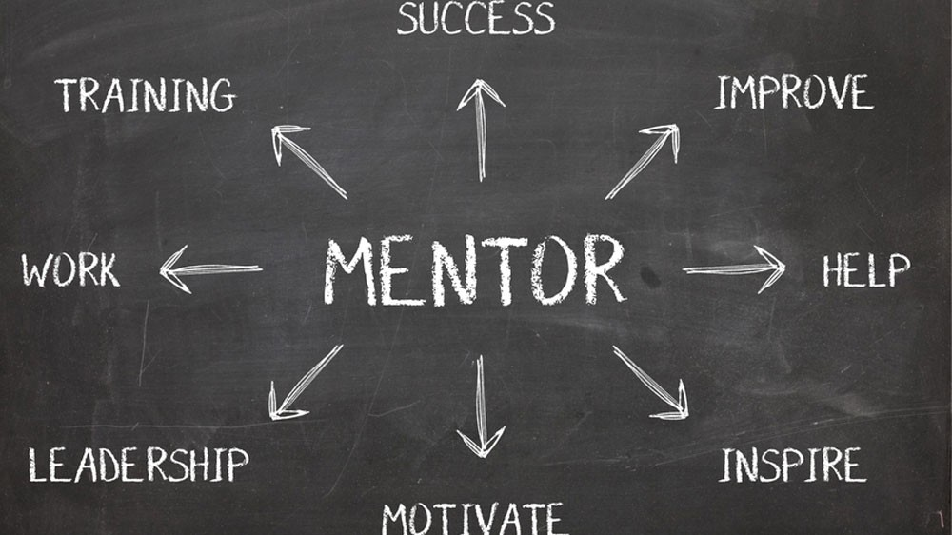
Men

Slide 15
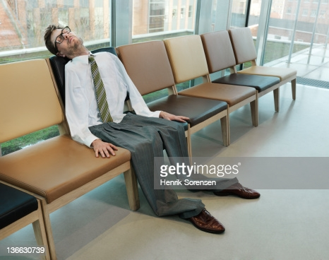
Did you feel Deflated after your Second meeting?
Make that connection
Boost yourself, be self motivated
Stay committed even if your sponsor is no longer a member of the organization

Slide 16

Ignite the passion that burns in your soul to give of yourself daily to help those in need. Keeping Pilots involved, informed, spark joy and integrated are ways to help ignite their passion. Let the spark turn into a roaring flame, burning so brightly that others will want to warm up in its glow and light their candles by your flame. Don’t hide your Pilot light under a bushel, place your light on a hill just like the lighthouses that shine their light warning ships of the jagged rocks or beckoning vessels to safe harbor.

Slide 17

Inclusion are we embracing and welcoming new Pilots?

Slide 18

Retention is more than just numbers
Like minded people coming together in friendship, to achieve one common goal to make a difference in the lives of others.

Slide 19
Friendship and Service is our core principals
I ask the question are we friendly?
When was the last time you shared your Pilot Story with a stranger?
Are you an undercover Pilot?
How often do we serve?
Are we setting a good example for others to follow?

Slide 20


Slide 21
Final R’ Reclaim
Recruited
Retained
Reclaimed

Slide 22


Slide 23
The Final R Reclaiming Members
Reclaiming through effective win back programs is the final R in our discussion
Not everyone renews year after year –so what do you do about those who don’t renew?
Win ‘em back or at least find out why they won’t come back and look at improvements you can make, based on non-renewing member feedback
Presented by:
Rhona Espinoza;
Vice President Pilot International 2020/21

Slide 24

A MEMBERSHIP REACTIVATION CHECKLIST
• Set objectives, contact non-renewing members with a purpose-do you have new benefits to offer? More value? Improved conditions? What can you do to win this member back on the spot?
• Coupled with the above, steer away from the same old ‘blah, blah’ formula, letter 1, letter 2, letter 3 format.
• What do I mean by that?
What did you achieve last year? Can you set a benchmark from last year’s results that will give you targets for this year?

Slide 25

CHECK LIST CONTINUE
• A direct mail renewal/reactivation notice is fine, as long as it contains real renewal benefits and value.
• Make your final renewal notice time specific, and then follow with a phone call if they miss the date.
• Yep-the phone call. A tightly scripted telemarketing campaign can increase your renewals by 40%. For those of you looking horrified at the use of the word ‘telemarketing, bye for now-for the rest of you, a telemarketing campaign can be conducted by your members.
• At renewals time everyone in your club should live and breathe renewals-it is a shared responsibility

Slide 26




Slide 27
GAIN RESEARCH AND FEEDBACK FROM NON-RENEWING MEMBERS OR CONDUCT A LONG MEMBER INTERVIEW. Ask questions!
• If all your efforts do not re-engage a member, try to find out if they are willing to share their reasons. Keep the following tips in mind as you talk with them:
• Tell the person that you are hoping to learn from his or her experience and listen to them. Don’t be defensive or interrupt. Take notes. Ask questions to gain deeper insight.
• Ask for permission to share what you learn with appropriate people to help the club improve.
• Thank them for sharing and offer apologies for expectations that were not met.

Slide 28

Why not gain something even if they don’t renew?
• Improve! Use the data you gather for continual improvement.
• Keep non-renewing members in the know as to your club’s events and happenings by retaining them on the email distribution list and task a member in the club to make a few follow up calls through the year to each non-renewing member.

Slide 29


Slide 30
THANK YOU

