Slide 1


Presenters: Avaline Adams and Beverly Garner

Slide 2
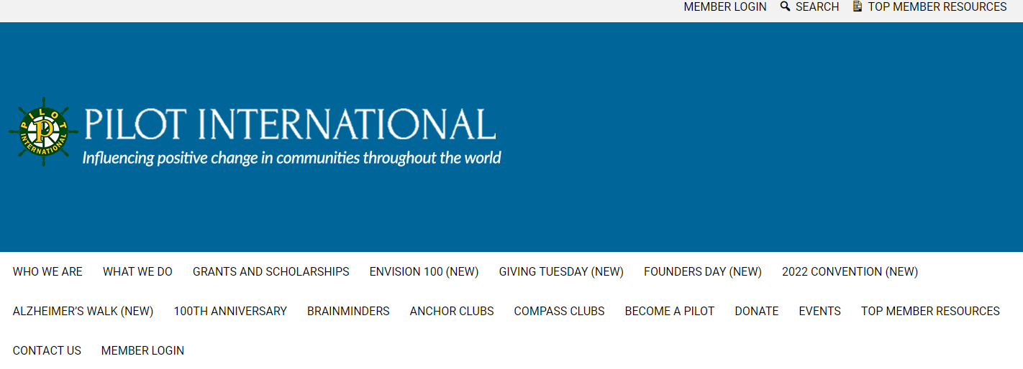
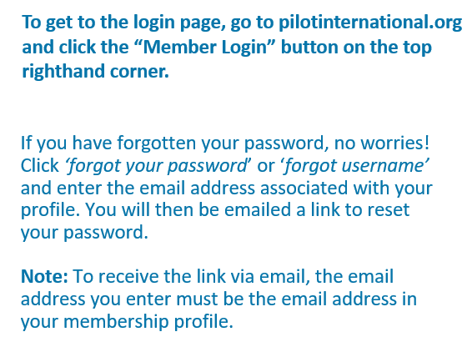
Take control of your membership

Slide 3
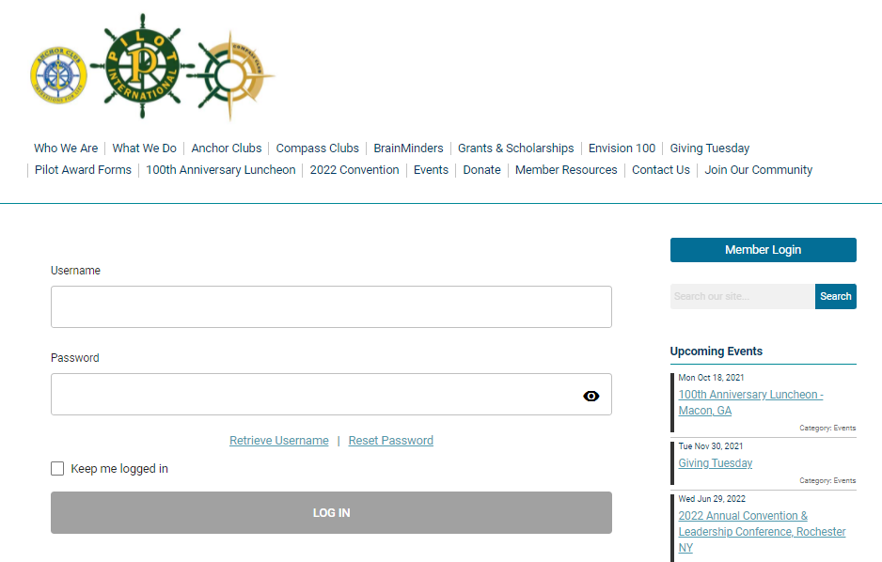
Take control of your membership

Slide 4
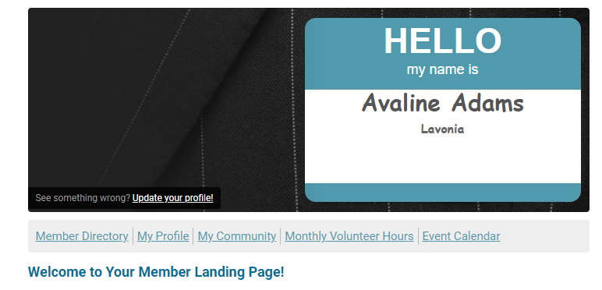
You have successfully logged in!

Slide 5
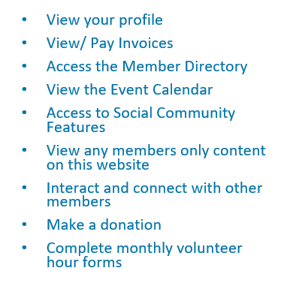
What can I do now?

Slide 6
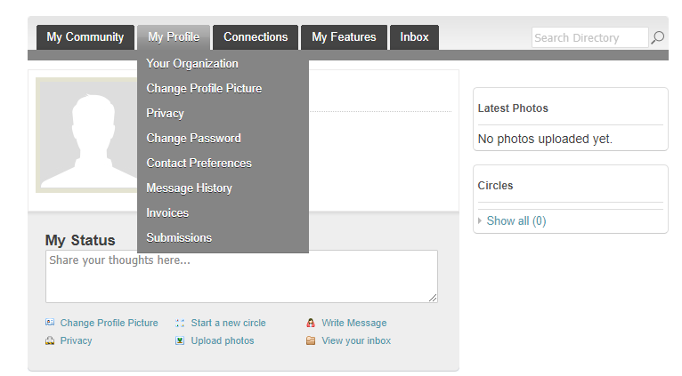
If you hover over the words ‘My Profile’, you
can make changes to your profile.
In this area you can:
Change your profile picture that shows on the Member Directory
Edit your privacy settings
Change your password
Manage how PI contacts you
View past emails PI has sent you
View a list of all your invoices
View all forms you have submitted

Slide 7
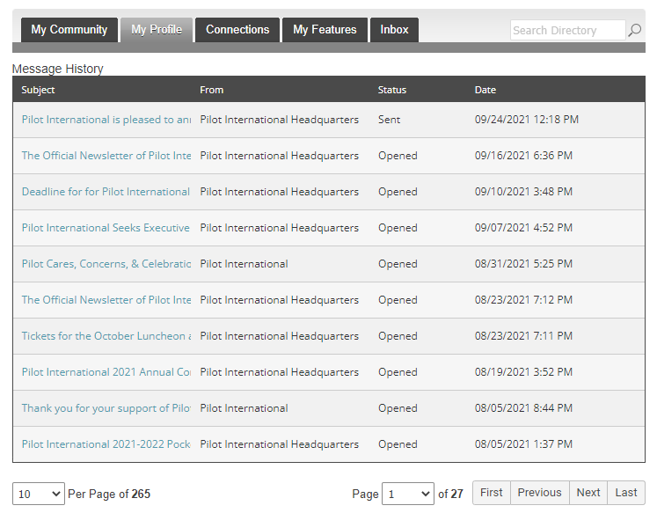
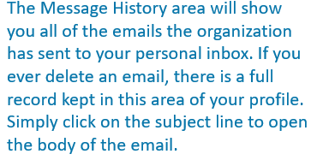
View History
Messages

Slide 8
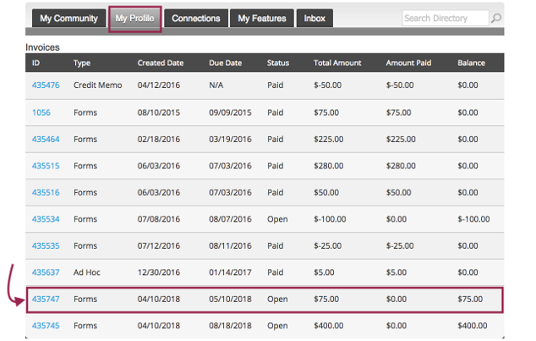
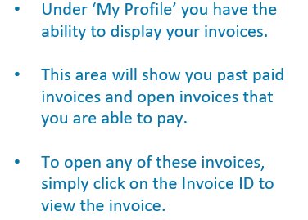
View your
invoices

Slide 9
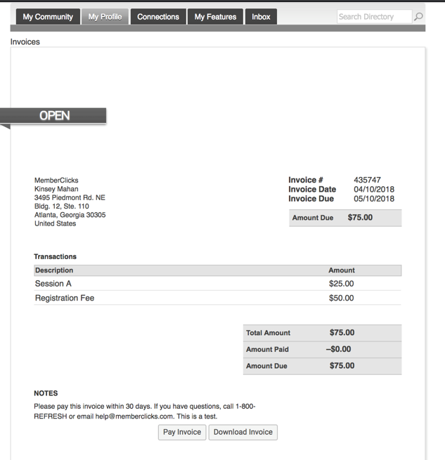
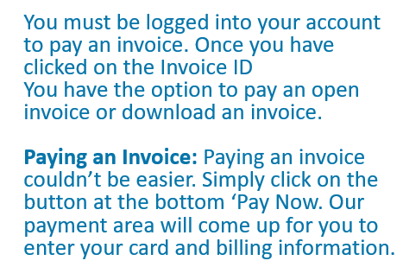
Pay your invoices

Slide 10
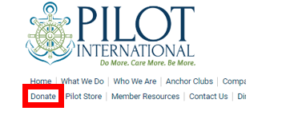
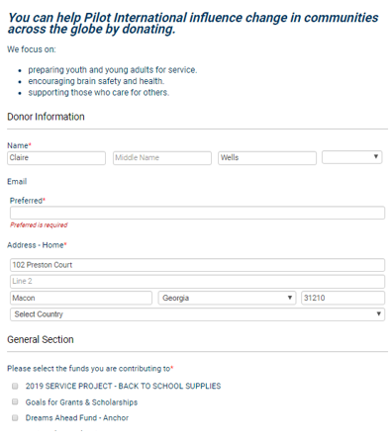
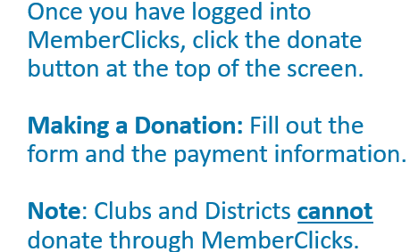
Make a Donation

Slide 11
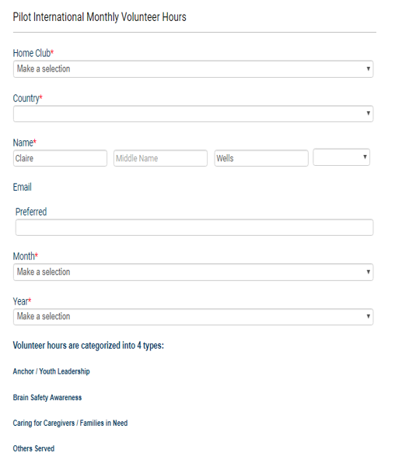
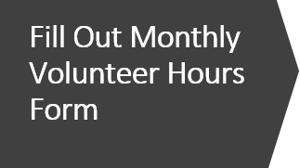
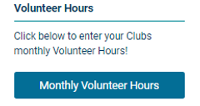
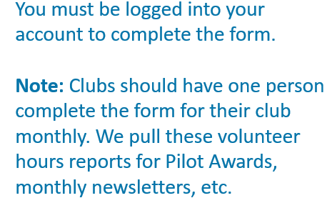

Slide 12

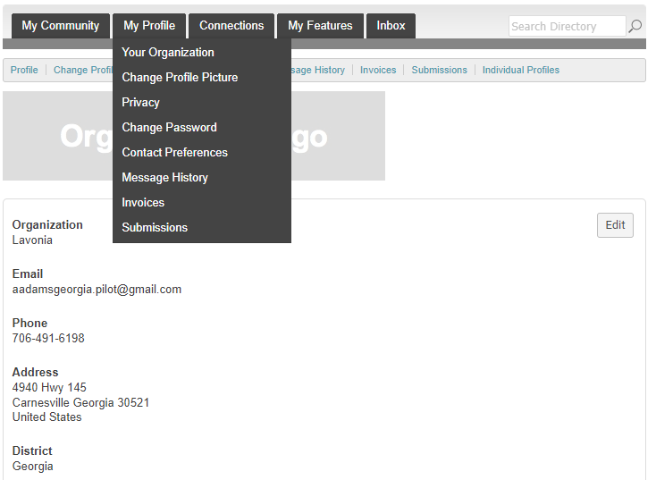
Organization Structure
Key Contacts Changes to Organizational Profiles
If you are the Key Contact (aka. Admin) to your club, you are able to make changes to the club’s profile through your individual profile.
To update your Club’s profile, hover your mouse
Over ‘My Profile’ and click on ‘Your Organization’.

Slide 13
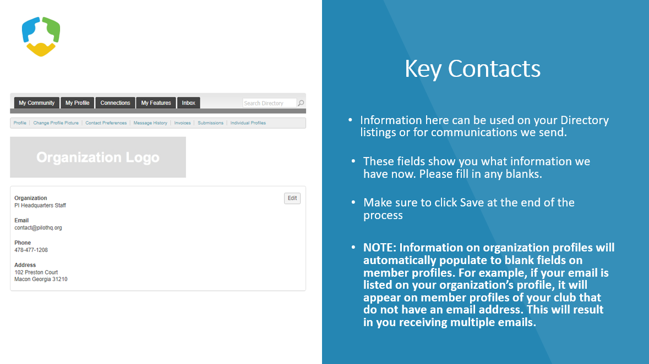

Slide 14
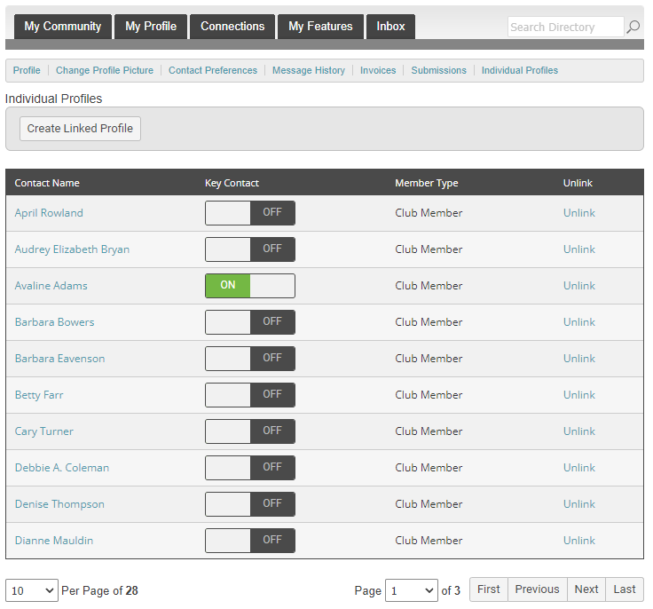
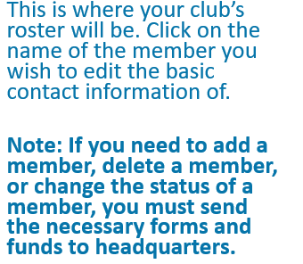
Key
Contacts

Slide 15
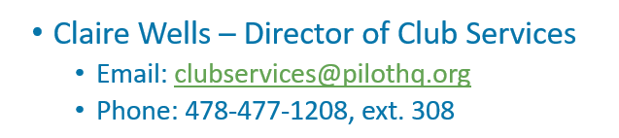
Need Help? Call Claire!!
See Post Convention Workshops – MemberClicks for in depth tutorial

