Slide 1
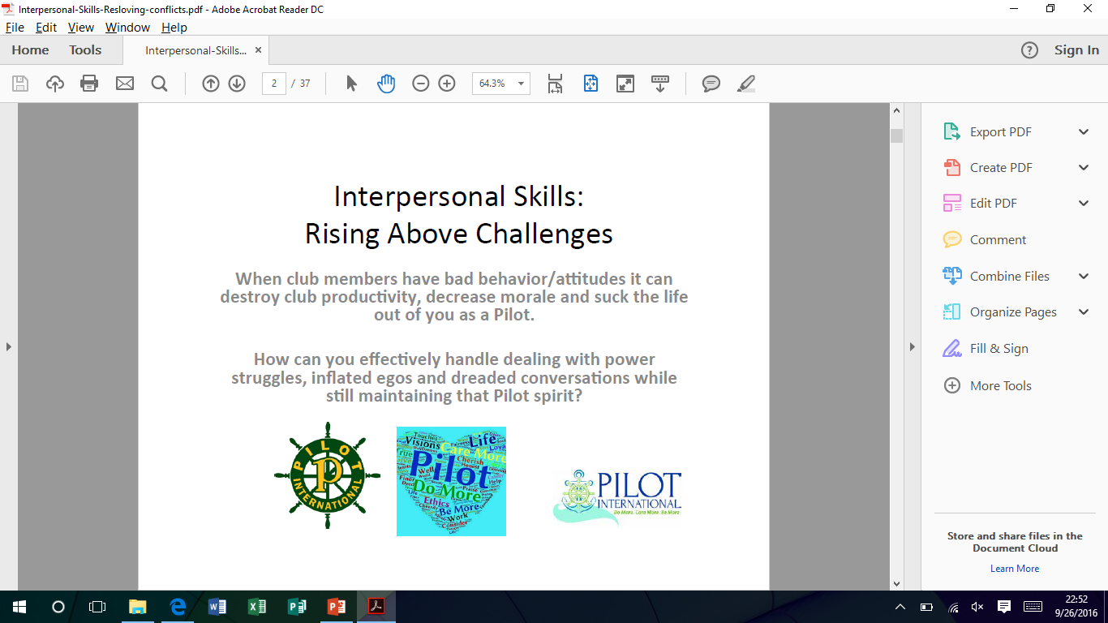
Positive Communication
Interpersonal Skills: Rising Above Challenges
Notes:
When club members have bad behavior and/or attitudes,
it can destroy club productivity, decrease morale and suck the life out of you as a Pilot.
How can you effectively handle dealing with power struggles, inflated egos and dreaded conversations
while still maintaining that Pilot spirit?

Slide 2
In this workshop, you will learn how to develop interpersonal skills and discover:
How to create an environment of mutual respect strategies that work
Proven tactics to keep your cool during heated discussions
Communication skills that help you deal with difficult club members positively
Best known approaches to help solve problems promptly and accurately
Tips for forging effective partnerships with your club members

Slide 3
SILENCE is not Communication!

Slide 4
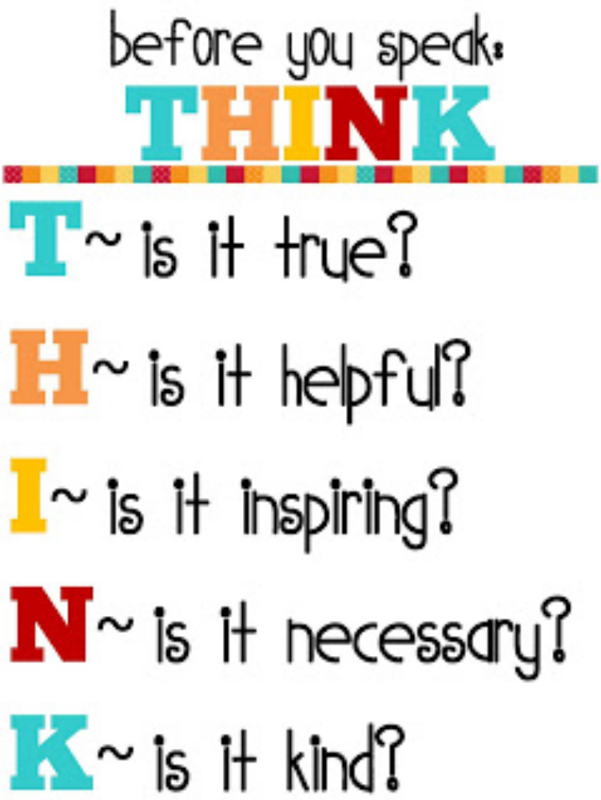

Slide 5
Communication has consequences
You may say, “I take it back.” But you really cannot.
Notes:
You may say, “I take it back.” But you really cannot.
It’s better that you don’t ‘give it’ in the first place.
It’s better that you think before you speak.

Slide 6
Before you speak, ask yourself:
Will what I say cause damage to a relationship with people important to me?
Will what I’m going to say be considered a criticism?
Will what I plan to say bring sunshine to a dim place?
Notes:
Will what I say cause damage to a relationship with people important to me?
Which is more important to me: to say what I want to say, or to continue a positive relationship?
Will what I’m going to say be considered a criticism?
If so, shouldn’t I wait until a more suitable time and place? Shouldn’t I say that in private?
Will what I plan to say bring sunshine to a dim place? Or will it bring darkness?
Will it open a window of opportunity for someone or some idea? Or will it close a door in someone’s face? Will it create or kill?

Slide 7
Getting emotional desires met
There are three fundamental emotional desires that people seek to get met:
They want to feel included.
They want to feel competent.
They want to feel accepted.
Notes:
There are three fundamental emotional desires that people seek to get met:
They want to feel included ~ Happens when they are feeling recognized
They want to feel competent ~ Happens when they have a feeling of control over their contributions/work
They want to feel accepted ~ Happens when they are feeling liked by club/community/family members
How do we know what others want?
We LISTEN…

Slide 8
Observe with our eyes and listen with our
E
A
R
S
Empathize
Accept
Respect
Support
Notes:
Empathize with the people in your club/district ! Think about how each person feels ! Show that you care ! Try to make the person feel better.
Accept the person ! Accept the person-­‐-­‐-­‐even if you don’t like the way the person acts ! Accept the person-­‐-­‐-­‐even if the person’s ideas don’t seem right.
Respect the person. ! Honor and respect the people in your club/district ! Seek to understand the people in your club/district in the context of their personal history, their social and family networks and their hopes and dreams.
Support people ! Support people in your club/district to enhance their confidence and assertiveness.

Slide 9
Five crucial characteristics for maintaining positive relationships
Treat Everyone with Respect & Common Courtesy
Do What You Say You Will Do
Be Proactive
Check Your Facts
Be Accountable for What You Do
Notes:
Treat Everyone with Respect & Common Courtesy:
Listen carefully. Thank people when appropriate.
Be polite even when people are rude. Be polite to those with whom you disagree.
Return phone calls, e-­‐mails, texts as quickly as possible.
2. Do What You Say You Will Do:
Follow through on commitments. Be reliable. Be on time for meetings.
If unable to follow through, tell someone there is a problem and make an attempt to compensate.
3. Be Proactive:
Focus efforts on how to anticipate and solve problems before they happen, rather than how awful things are and how many problems you cannot solve.
4. Check Your Facts:
Do not rely on hearsay or gossip. Obtain information from several sources before taking a position on an issue.
5. Be Accountable for What You Do:
Acknowledge failures as well as successes. Admit mistakes and learn from them.
One VERY IMPORTANT tool to communicate well is TACT…

Slide 10
What is Tact?
“Respond intelligently, even to unintelligent treatment.” – Lao-­‐Tzu, Chinese philosopher
Tact is the ability to tell the truth in a way that considers other people’s feelings and reactions.
Notes:
Tact is the ability to tell the truth in a way that considers other people’s feelings and reactions.
Tact encompasses many things, including emotional intelligence, respect, discretion, self-­awareness, thoughtfulness, compassion, subtlety, honesty, diplomacy, and courtesy.

Slide 11
Why is Tact Important?
Preserving existing relationships
Building new relationships
Opening new opportunities
Avoiding conflict
Notes:
The ability to communicate with sensitivity offers many benefits.
Tact allows you to preserve existing relationships, especially when delivering bad news or providing critical feedback, whether in personal or professional situations.
Tact helps you build new relationships. Communicating tactfully strengthens your reputation and builds your credibility.
A tactful approach shows character, maturity, professionalism, and integrity.
Tact also demonstrates good manners.
If you can communicate with grace and consideration, you’ll stand out from the crowd, and you’ll get noticed for the right reasons. This can lead to great opportunities.
Finally, tact can help you to avoid conflict, find common ground, and allow others to save face. It can therefore be an important asset in negotiations and conflict resolution.
Tact reflects emotional sensitivity and increases the likelihood of a positive outcome.

Slide 12
Developing Tact
Create the Right Environment, and Think Before You Speak.
Determine the Appropriate Time.
Choose Your Words Carefully.
Watch Your Body Language.
Never React Emotionally.
Notes:
Use these strategies to communicate with tact:
Create the Right Environment, and Think Before You Speak. How many times have you spoken too quickly, and then regretted it?
Practice active listening when others speak. Use empathy and emotional intelligence to connect with people, and to see things from their perspective. Work to build trust, so that people know that your intentions are honest and compassionate.
2. Determine the Appropriate Time.
Your colleague has just found out that she’ll be laid off at the end of the year, while your boss has just told you about your promotion. Is now the best time to talk about your good news? Definitely not! Tact means saying the right thing at the right time. Consider your situation before you speak, and be discreet. Make sure that you stay conscious of who you’re with – and where you are – before you speak.
3. Choose Words Carefully.
Your choice of words can influence how others perceive your message. Avoid starting sentences with the word “you.” For example, saying “You need to have shorter meetings” will make the other person feel defensive. Instead, consider using a softer, more indirect language, like, “At our next business meeting, I think our meetings would be better if we stuck to the agenda and kept side conversations to a minimum.”
It’s especially important to use “I” statements during conflict, or when you give constructive criticism. When you do this, you take ownership of your feelings instead of placing blame. For example, say, “I see it differently,” or “I had to go over that section several times before I understood your message.”
Also, when you’re in a tense conversation, be concise. It’s tempting to keep talking when you feel uncomfortable, which increases the chance that you’ll say too much or say something that you’ll regret. Be honest and assertive, and only say what you need to say.
4. Watch Your Body Language.
A club member tells you that they are “fine”. But, as they speak, they avoid your gaze and folds their arms across their chest. Although their words are neutral, their body language makes you question their message.
When you’re tactful, your body language matches your message, and you appear open when you’re communicating, even if you’re giving bad news. For instance, make eye contact, don’t cross your arms or legs, don’t point, and practice good posture. Open body language and a courteous vocal tone communicate your truthfulness and willingness to work together.
5. Never React Emotionally.
It’s hard to communicate tactfully when you feel angry or upset. Give yourself time to calm down before you respond. Learn how to control your emotions. To calm down from a stressful situation, take a break from it and go for a walk, or use deep breathing techniques to regain your composure.
It’s also important to understand people, words, issues or situations that can cause you to communicate without tact. Think back to the last time you lost your temper or said something you later regretted. Why did you react this way? What caused you to lose control?
When you understand your triggers, you’ll be better able to control your emotions or walk away in the future.

Slide 13
How Tact Can Make the Difference
Giving Feedback
Deflecting Gossip
Handling Disagreements
Notes:
How Tact Can Make the Difference Between A Positive and Negative Experience:
Giving Feedback:
It can be difficult to give feedback, especially when it’s negative. The key to providing effective feedback is to give it frequently, and to do it tactfully.
A good approach can be to “sandwich” constructive feedback between positive comments. When you start off with something positive, this helps the person to relax, and it reminds them that they’re doing a good job. And, when you end with a positive, people don’t walk away feeling upset. Avoid sandwiching the constructive feedback between too many positives – people may take away the wrong message. Avoid using this approach too often, as people may come to mistrust positive feedback from you.
Deflecting Gossip
A club member is known as the gossiper and she is spreading rumors about another Pilot when you are in the room. You can tactfully deflect and neutralize the gossip in several ways: Say something positive: “Jane might struggle with parliamentary procedures, but she is a dedicated Pilot.” Or, ask them to stop: “I don’t want to talk about this especially since we don’t know the facts. Let’s discuss the upcoming fundraiser instead.” You can also say: “I don’t want to talk about people behind their backs,” or, “Let’s talk about this when Jane is here, so that she can address these issues.”
Handling Disagreements:
Tact is particularly useful in conflict resolution, because it can relieve tension, remove blame, and allow both sides to save face.
Imagine that you and another club member have argued over who gets to run the next fundraiser. This club member has run the last two fundraisers, and she wants to lead this one because it fits with her expertise. Before you insist that you take over this fundraiser, think about her position. She ran the previous fundraisers with finesse and professionalism. Also, this fundraiser is a perfect fit for her – you might struggle with it because you don’t have her experience.
A tactful response to this conflict would be: “You’re right. You should run this fundraiser because it matches your skills. I need some practice in a team leadership role, too, so how do you feel about me shadowing you, and then leading the next fundraiser?”

Slide 14
Resolving Disputes
Never attempt to sort out problems at times of high emotion.
Think about what your ideal solution to the problem would be.
Ask a trusted friend for advice if you feel out of your depth.
If you have a dispute with a club member, do make sure that you both clear the air afterward.
Notes:
Resolving Disputes
Try these ideas the next time tensions rise and tempers flare:
• Never attempt to sort out problems at times of high emotion. Always give yourself and the other party some time to cool down when necessary.
• Think about what your ideal solution to the problem would be. What compromises are you willing to make?
• Ask a trusted friend for advice if you feel out of your depth.
• If you have a dispute with a club member, do make sure that you both clear the air afterward. Aim to understand the origin of your disagreement and work at acknowledging each others’ perspective.

Slide 15
Resolving Disputes
Choose your language carefully.
Aim to set some action points for the future.
Plan to follow up.
Notes:
Choose your language carefully. This isn’t about accusations, but it is about mutual respect and understanding. Even if that isn’t what is forthcoming, you don’t need to lower your own standards!
Aim to set some action points for the future. How will you work more effectively together in the future?
Plan to follow up --- communicate about these issues in the near future, just to offer the opportunity to clear any residual anxieties.
Remember, your worst “enemy” can become your greatest ally if you take the time and effort to understand where you’re both coming from. Never write off a relationship, but do be aware that a healthy resolution may take work on both sides. Be prepared for that and the rewards are there for the taking.

Slide 16
Give More Encouragement and Complain Less
Be Aware
Be Thankful
Pause Before You Begin
Be Accountable
Notes:
Here’s How to “Complainless”
1. Be Aware. Recognize your typical paths to complaining—what (who) sparks your tendency to gripe. Minimize your exposure to them (eliminating those ‘sparks’ altogether may not always be realistic or the best thing). Know that your grumbling is a complete waste of energy.
2. Be Thankful. Regularly reflect on all the good in your life (people, opportunities, things). Understand and enjoy how lucky you really are. Be entitled to nothing.
3. Pause Before You Begin. Clip a compliant as you feel it coming. Put a smile or thoughtful statement in its path. Blame no one. Blame nothing.
4. Be Accountable. Focus on solving problems rather than having them. Set the example for others and recommit when you slip. Care for yourself and create a positive habit.

Slide 17
Communication

